Slide 1
COMM 204: LOGISTICS AND OPERATIONS MANAGEMENT
2022W MIDTERM REVIEW SESSION
Notes:
Introduce myself and explain what CMP is

Slide 2
COMM204
Today's session:
Process Analysis
Little’s Law
Variability
*OM Triangle
Queuing Theory
*Pk formula
+stick around for my top 204 study tips
Notes:
Remember to include breaks every 30 minutes
Run down of what the session willlook like

Slide 3
1
Process Analysis
Notes:
Explain what process analysis is and why we use it
Turning inputs into outputs.
Process definition

Slide 4
Process Analysis
Core Concepts: Flow Time, Capacity Rate, Bottlenecks
Flow time (Throughput time): lengths of time a unit spends in a cycle.
Capacity Rate: maximum rate at which units can flow through a process
Bottleneck: the “slowest” resource of the process- can determine the capacity rate of the process.
Starbucks Barista Crafting Beverage Process:
Flow time: how long it takes to make the drink.
Capacity rate: maximum rate at which drinks can be made (usually either in a minute or hour)
Bottleneck: which part of the beveraging crafting process slows the process down the most?
Notes:
Explain that these are the core concepts of process analysis, read slide

Slide 5
Process Analysis
Process Entities
Flow Units: The items that flow through the process
Activities: the transformation steps in the process
Resources: what performs the activity- have capacities
Buffers: storage units for flow units- may have finite size, ex: waiting room and queues
Decision points: “forks in the road”
Theoretical Flow Time: amount of time that a flow unit is in the process
Unit load: amount of time that a resource needs to process a flow unit
Notes:
Explain all of these, and add in the starbucks example and give starbucks related examples
-include shapes

Slide 6
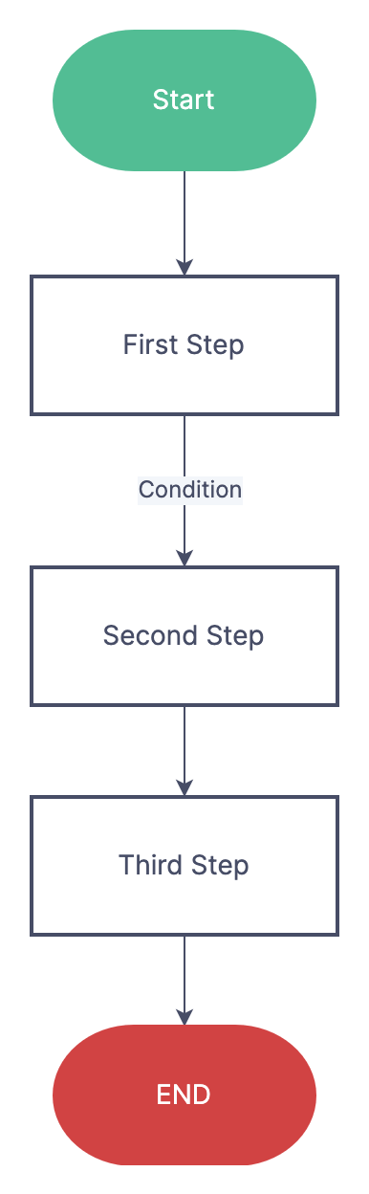
Analysis Presentation
Linear Flow Diagram
Note the shapes!
Square- Activities
Triangle- buffers
Diamond- decision points
Arrow- flow of materials
Notes:
“SO HOW ARE WE GOING TO SEE THIS INFORMATION”

Slide 7
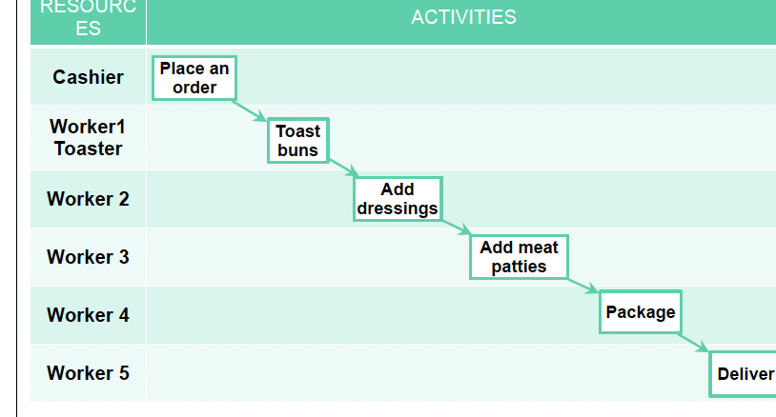
Analysis Presentation
Swim Lane Flow Diagram

Slide 8
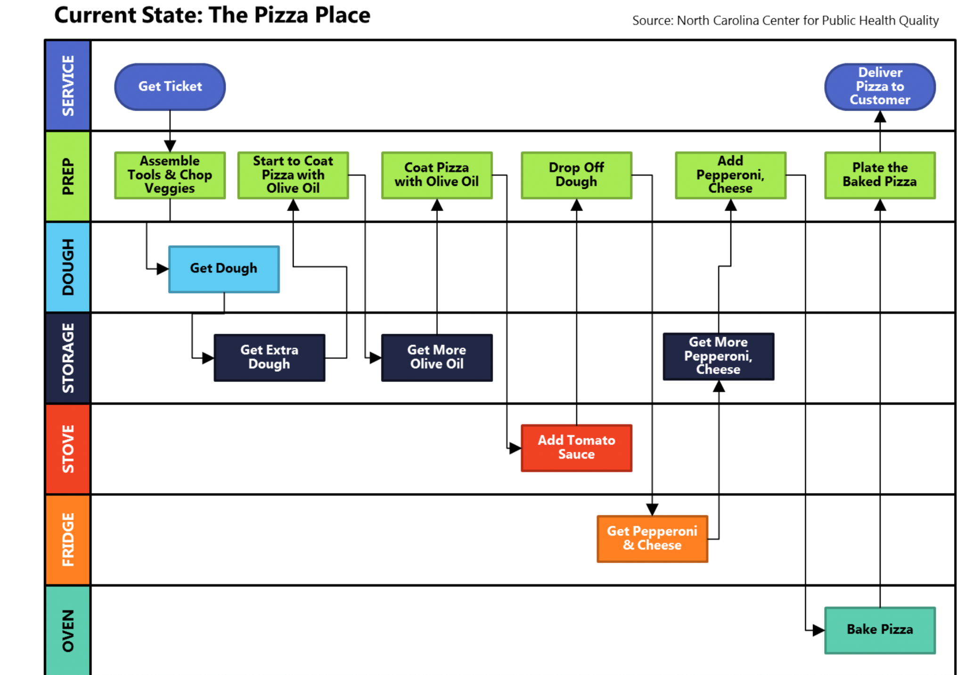
Analysis Presentation
Swim Lane Flow Diagram- complex

Slide 9
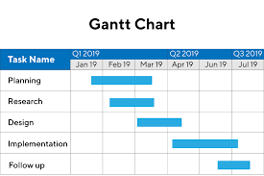
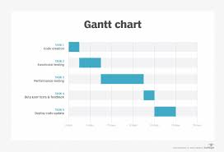
Analysis Presentation
Gantt Diagram
-often used in project planning

Slide 10
Process troubles
Blocked process
First step: 60/ hour
Second step: 40/ hour
Starved process
First step: 40/hour
Second step: 60/hour
Notes:
There are two types of processes that can be classified as unbalance and cause processing delays.
Unbalanced processes
Blocked process- when next stage is busy
Starved process- when first stage is taking too long

Slide 11
How to increase capacity rate
Increase the size of the resource pool. (add a worker or machine)
Decrease the unit load ( with better technology)
*applying either of these to a resource that is not a bottleneck will not increase capacity rate
Notes:
Reminder of what resource pool
Can change theoretical flow time (will lower the total flow time) : remind what theoretical flow time is

Slide 12
Practice Question
Identify the bottleneck, capacity rate, theoretical flow time.
Provide one suggestion on how you could reduce capacity rate in this process.
CASHIER | WORKER 1 | WORKER 2 | WORKER 3 | WORKER 4 | WORKER 5
10 SEC | 5 SEC | 15 SEC | 8 SEC | 6 SEC | 12 SEC
Notes:
Identifying flow time, capacity rate and bottle neck.
-one suggestion for improving process and how you would do it?

Slide 13
Answer
Identify the bottleneck, capacity rate, theoretical flow time.
Provide one suggestion on how you could reduce capacity rate in this process
Capacity Rate: 4/ min
Bottleneck: worker 2
Theoretical flow time: 56 seconds
CASHIER | WORKER 1 | WORKER 2 | WORKER 3 | WORKER 4 | WORKER 5
10 SEC | 5 SEC | 15 SEC | 8 SEC | 6 SEC | 12 SEC
Notes:
Identifying flow time, capacity rate and bottle neck.
-one suggestion for improving process and how you would do it?

Slide 14
Question!
What happens if someone wants to skip worker 2s job? Ex: it is adding cheese to a patty, and you are lactose intolerant. What is new throughput rate, capacity rate, bottleneck resource and theoretical flow time?
CASHIER | WORKER 1 | WORKER 2 | WORKER 3 | WORKER 4 | WORKER 5
10 SEC | 5 SEC | 15 SEC | 8 SEC | 6 SEC | 12 SEC

Slide 15
Answer
What happens if someone wants to skip worker 2s job? Ex: it is adding cheese to a patty, and you are lactose intolerant.
Capacity rate: 5/ min
Theoretical flow time: 41 sec
Bottleneck: worker 5
Throughput rate: 5 / min
CASHIER | WORKER 1 | WORKER 2 | WORKER 3 | WORKER 4 | WORKER 5
10 SEC | 5 SEC | 15 SEC | 8 SEC | 6 SEC | 12 SEC
Notes:
Use this page to help explain implied/ short run utilization

Slide 16
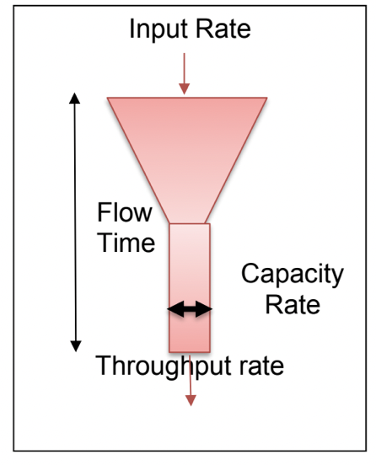
Visualizing Terms
Throughput Rate: actual output rate
Input Rate: Rate at which flow units arrive at the process
Flow time: average time for a unit to move through the system
Cycle Time: average time between completion of units
Notes:
When input rate > capacity rate, capacity rate = throughput rate
When input rate < capacity rate, throughput rate = input rate
When demand rate ( input rate) = capacity rate, you can be asked to calculate short run utlizations.

Slide 17
Utilization
Utilization how “used” a resource is
Throughput Rate / Capacity Rate AKA
Actual Output Rate / Maximum Output Rate
*Maximum 100%
What is utilization of worker who gets through 4 units per hour when they could get through 6 per hour?
Notes:
Relate this to the funnell analogy
-mention ideal utilization
How much the resource is actually being utilized

Slide 18
Implied Utilization
Captures the idea of overtime/ excess demand in the short run
Input Rate / Capacity Rate
Maximum CAN be over 100% in the short run
Ex: temp holiday employee labour
Notes:
How muc the resource is being used in response to customer demand
Go back three slides to make an example of this concept

Slide 19
Your turn!

Slide 20
Calculate the long term utilization!
 | Throughput Rate | Capacity Rate | utilization as a %
Cashier 1 | 4 | 5
Cashier 2 | 6 | 10
Cashier 3 | 2 | 3
Notes:
This will prove to be useful with our pk formula
In this example, the cashier are working against their own capacity rate.
But there may be questions when you are asked to calculate utilization in examples with the same capacity rate

Slide 21
Calculate the long term utilization!
 | Throughput Rate | Capacity Rate | utilization as a %
Cashier 1 | 4 | 5 | 80%
Cashier 2 | 6 | 10 | 60%
Cashier 3 | 2 | 3 | 66.6%
Notes:
This will prove to be useful with our pk formula

Slide 22
Inventory

Slide 23
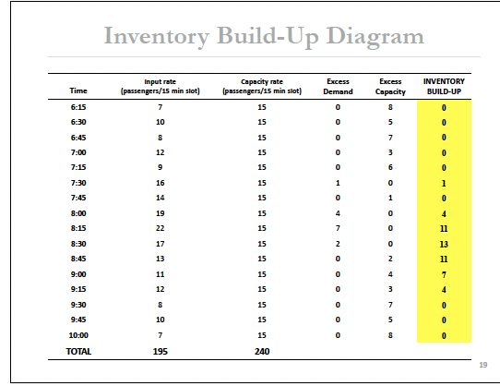
Inventory build up
Inventory buildup occurs as a result of short run input rate > short run capacity rate
Notes:
Relate to implied utilization? So what happens if implied is over 100%?
Note that short run is important here, a business cannot operate if long term inputs move faster than long term capacity rates - logical thinking

Slide 24
Average Inventory Build Up
Average Inventory: Sum of inventory build up/ number of time slots.
What is average inventory in this case?
Notes:
Average inventory is a calculation we do as a result of having inventory build up. Ths can help with inventory management.
Answer: 3.1875

Slide 25
Average Inventory Build Up
Average Inventory: Sum of inventory build up/ number of time slots.
What is average inventory in this case?
(0+0+0+0+0+1+0+4+11+13+11+7+4+0+0+0) / 16
= 3.1875
Notes:
Average inventory is a calculation we do as a result of having inventory build up. Ths can help with inventory management.
Answer: 3.1875

Slide 26
Inventory
Discrete Average Inventory: Start Inventory + Ending Inventory / 2
Days in inventory: 365/ inventory turnover
Inventory turnover: Cost of Goods Sold / Average Inventory
Think comm 293**

Slide 27
Who has the lower inventory turnover, how many days are goods spent in inventory?
Sarah: $15,000 goods sold, with average inventory of 670.
Claire: 60000 goods sold, average inventory of 780.

Slide 28
Who has the faster inventory turnover, how many days are goods spent in inventory?
Sarah: $15,000 goods sold, with average inventory of 670.
Inventory turnover -15000/ 670 = 22.38
Days in inventory- 365/ 22.38 = 16.3
Claire: 60000 goods sold, average inventory of 780.
Inventory Turnover 60000 / 780 = 76.9
Days in inventory 365/76.9= 4.75

Slide 29
Process Analysis Summary
- Understand how to identify unit load, capacity rates, bottleneck
-Be able to figure out ways to shorten/ balance out processes (increase capacity rate)
-Identifying and calculating Inventory data

Slide 30

Notes:
Share during 1st break

Slide 31
2
Little’s Law
Notes:
Discrete average inventory, this helps with continuous average inventory
Establishes a relationship between average inventory, average throughput rate and average flow time

Slide 32
Little’s Law
I = R*T
I- Average Inventory
R- Average Throughput Rate
T- Average Flow Time
Be careful not to mix up R and T!
Notes:
T for time
R for Rate
This is something i always got confused!
AVERAGE AVERAGE AVERAGE
Simple calcuaiotkion but IMPORTANT concept, so dont forget it

Slide 33
Practice Questions
At Lions Gate hospital, there are 15 births a day.
75% of deliveries require a 1 day stay. 25% of deliveries require a 3 day stay.
What is average occupancy of delivery floor?
On average, there are 50 people waiting for a given surgery.
On average, 10 surgeries are performed a year.
With the assumption that no patients die, how long do patients wait?
Notes:
Littles law practice question

Slide 34
Practice Answers
R = 15 births/day
T = 1*0.75 + 3*0.25 = 1.5 average flow time
I = 15 * 1.5 = 22.5 patients in the occupancy on average
I =50 patients waiting
R = 10 surgeries/ year
T = 5 years
Notes:
Littles law practice question

Slide 35
Little’s Law summary
I = R*T
R = I/T
T = I/R
-correctly identify variables
-remember this is all “average”
-keep an eye out for units
Notes:
If you see average, consider that littles law could assist you through the question. They may not directly state to use the littles law, you may have to use intuitive thinking skills, and reealize this concept could help you
May see questions like lions gate where customers are segmented- more challenging question.

Slide 36
3
Variability in Processes
Notes:
Variability is bad information in processes
-

Slide 37
Variability
Variable Inputs: ex: not knowing exactly when customers will show up to your store
Variable Capacity: not knowing what your capacity will be. Ex: farmers producing crops.
Notes:
Variability in processes occurs when the process has the potential to not go exactly as planned, and this arises from two variables: inputs and capacity.
Variability occurs from two things: variable inputs and variable capacity
Crop capacity can vary with weather conditions.
Inputs: better forecasting and better scheduling
Process: reduce process variability, better quality

Slide 38
Types of Variability
Predictable: knowable changes in an input and/or capacity rates
Ex: Advent Calendar sales will go up during christmas time.
Unpredictable: unknowable changes in input and/or capacity rates
Ex: how much will advent calendar sales increase during Christmas time?.

Slide 39
Your turn!

Slide 40
Examples: Predictable or Unpredictable
Categorize these examples as knowable or unknowable information.
Demand of chocolates going up during Valentines day.
Power outage of all processing plants.
New Machines breaking down.
Employees not showing up for shifts.
Employees taking time off during exam season.
Notes:
Predictable, unpredictable, unpredictable, unpredictable, predictable. Some of these could be argued with more information, ex: if processing plants are located in a place with storms.

Slide 41
Examples: Predictable or Unpredictable
Categorize these examples as knowable or unknowable information.
Demand of chocolates going up during Valentines day.
Power outage of all processing plants.
New Machines breaking down.
Employees not showing up for shifts.
Employees taking time off during exam season.
Notes:
Predictable, unpredictable, unpredictable, unpredictable, predictable. Some of these could be argued with more information, ex: if processing plants are located in a place with storms.

Slide 42
Variability
Controlling Variability
Predictable: making changes to the system.
Unpredictable: result of lack of information. Reduce by getting info!!
Notes:
Ask what types of changes we could make in reference to the examples on the last page?
What type of information in relation to the last slide?

Slide 43
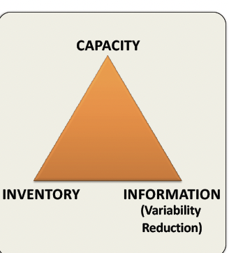
OM Triangle
Helps OM experts capitalize their strengths when facing random demand.
You cannot have low inventory, capacity and information. There is a trade off to pursuing capitalization of strengths.
Notes:
If asked the question “ what to do when you are not able to change capacity, or inventory, what do you do? Answers questions when you have two low spects of the triangle, how can you capitalize on your one strength?

Slide 44
4
Queuing Theory
Pk-Formula
Notes:
Now that we know that variability occurs in processes,
Explain there are 6 different formulas to use, and they are all simple nough to remember, but it is knowing when to use them that is important.
Which formula to use will likely be inidtcated in the question, but there is a chance it wont be and you need to be prepared to know which formula to use for a given question.

Slide 45
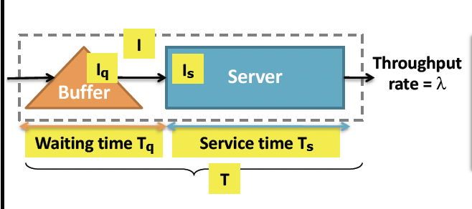
Queuing Theory
Iq: Average queue length
Is: Average number of customers being served
I: Average number of customers in the process = Is + Iq
Ts: Average time spent at server
Tq: Average time spent waiting in queue
Ts= Ts+Tq total average time spent in queue
Notes:
Things you can calculate with Pk formula

Slide 46
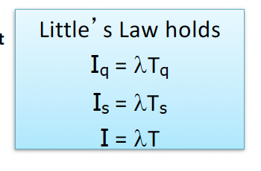
Little’s Law x Pk Formula
Little’s Law: Average Inventory = Avg Flow Time * Avg Throughput

Slide 47
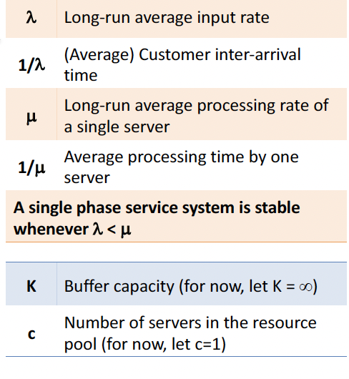
Queuing Theory
Notes:
Variables involved in pk formula

Slide 48
POLLACZEK-KHINCHIN (PK) FORMULA
Used to calculated average queue length (Iq). Ex: number of customers in line at Starbucks
Assumptions:
single queue
no limit on queue length
all units that arrive enter the queue
any unit that enters queue stays in system
FIFO
all units arrive independently of each other
Single server: we assume there is a single server unless other
Notes:
Assumptions for pk formula

Slide 49
SINGLE SERVER
Notes:
Single server will be indiciated in the question, so the next three formulas will be one of the ones to use when given a single server question. These questions are the same idea as multi=server, but considered easier because theyre easier calculation. However, at the end of the day, all the problems are are just plugging in numbers into equations

Slide 50
General Distribution
G/G/1
Generally Distributed Arrival times
Generally Distributed Service Times
1 server
Notes:
Distribution is based on probability

Slide 51
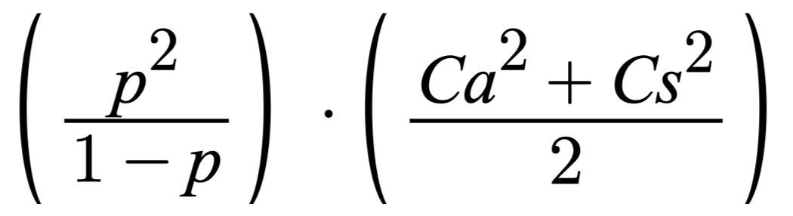
Single Server General Distribution Pk Formula
Iq=
P: Long Run Average Utilization
Ca: Coefficient of Variation of Interarrival Times
Cs: Coefficient of Variation of Service Times
Notes:
To figure out these questions i always write out the variables Iknow- same with littles law. Put all the information in front of you

Slide 52
P: Long Run Average Utilization.
λ /𝞵
Long Run average input rate / long run average processing rate of a server
Ca: Coefficient of Variation of interarrival times
σ{a}/ E {a}
Standard deviation of inter-arrival times / mean of inter-arrival times
Cs: Coefficient of variation of service times
σ{s} / E {s}
Standard deviation of service times / mean of service times
Notes:
So if you see “standard deviations” think general distribution

Slide 53
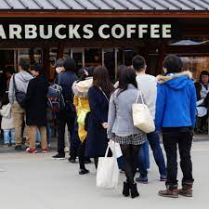
Example: Starbucks Line
Customers arrive at a rate of 4/ hour with a mean service time 12 minutes.
Assume standard deviation of interarrival time is 4 minutes, and the standard deviation of service time is 3 minutes.
Assume one server
What is the average queue length?

Slide 54
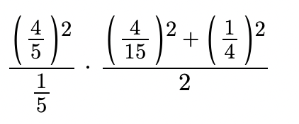
Answer: Starbucks Line
λ = 4 customers/ hour
𝞵 = 5 customers/ hour
Ⲣ = 4/5
σ{a}= 4 minutes (1/15 of an hour)
σ{s}= 3 minutes (1/20 of an hour)
E {a}= 15 minutes (¼ of an hour)
E {s}= 12 minutes (⅕ of an hour)
Ca= (1/15) / (¼) = 4/15
Cs= (1/20) / (⅕) = 1/4
= 0.214

Slide 55
Exponential/ Poisson Distribution
M/M/1
Exponential Distributed Arrival Times
Exponential Distributed Service Times
1 Server
Notes:
Use this when we dont know what the distribution is, so we have to make some assumptions
-question will say exponential or poission
-question will not include standard deviations, if it includes standard deviation (it might be a trick question!!)

Slide 56
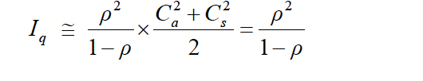
Single Server Poisson Distribution Pk formula
***Cs and Ca each equal 1 in this case
Notes:
Easaier? Just less to calculate
Explain why you d

Slide 57
Example: Starbucks Line
Customers arrive at a rate of 3/ hour with a mean service time 6 minutes.
Assume one server
What is the total time spent in the process?
Notes:
Profs may confuse you by putting a lot of unnecessary information, make sure you can identify the important data that is given in the question and be able to disregard info that doesnt apply to the question

Slide 58
Example: Starbucks Line
λ = 3 customers/ hour
𝞵 = 10 customers/ hour
Ⲣ = 3/10
Tq = 6
Ts = 1/ u = 1/10 = 6.01
T = 6.01 minutes
Total time spent in system
Is = 3/10
Notes:
Profs may confuse you by putting a lot of unnecessary information, make sure you can identify the important data that is given in the question and be able to disregard info that doesnt apply to the question
Know what the question is looking for, might not necessarily be IQ

Slide 59
Exponential/ Deterministic Distribution
M/D/1
Exponential Distributed Arrival Times
Determined Service Times- constant service times
1 Server
Notes:
If it gives you the service time, it has been determined and use this formula

Slide 60

Exponential Arrival and Determined Service Time
Ca = 1
Cs = 0 (because there is no variation as it is a determined service time)
Notes:
Explain why its ½

Slide 61
Example: Starbucks Line
Customers arrive at a rate of 6/ hour with a determined service time of 4 minutes.
Assume one server
What is the average amount of people in the process?

Slide 62
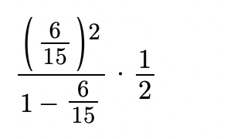
Example: Starbucks Line
λ = 6 customers/ hour
𝞵 = 15 customers/ hour
Ⲣ = 6/15
Is = 6/15
Iq= 0.1333
I = Is+ Iq =
0.5333

Slide 63
Notes:
Share during 1st break

Slide 64
MULTI-SERVER
Assumptions: In addition to all the single server assumptions.
c = number of servers
The first customer in line will be served by the next available server
P =λ /c𝞵

Slide 65
General Distribution
G/G/c

Slide 66
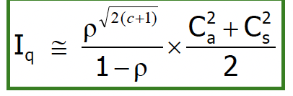
Multi-Server General Distribution Pk Formula
P =λ /c𝞵

Slide 67
G/G/c example
Customers arrive at a rate of 4/ hour with a mean service time 12 minutes.
Assume standard deviation of interarrival time is 5 minutes, and the standard deviation of service time is 2 minutes.
Assume 3 servers
What is the average queue length?

Slide 68
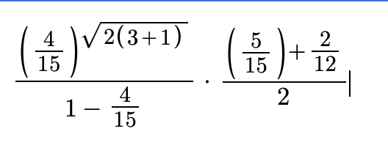
G/G/c example
P =λ /c𝞵
λ = 4 customers/ hour
𝞵 = 5 customers/ hour
Ⲣ = 4/15
σ{a}= 5 minutes (1/12 of an hour)
σ{s}= 2 minutes (1/30 of an hour)
E {a}= 15 minutes (¼ of an hour)
E {s}= 12 minutes (⅕ of an hour)
C = 3
Iq = 0.0081

Slide 69
Exponential/ Poisson Distribution
M/M/c

Slide 70
Multi-Server Exponential Distribution Pk Formula
P =λ /c𝞵

Slide 71
Example: Starbucks Line
Customers arrive at a rate of 6/ hour with a service time of 5 minutes.
Assume 2 servers
What is the average amount of people in the queue?

Slide 72
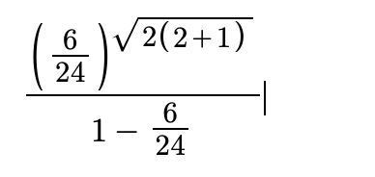
Example: Starbucks Line
λ = 6 customers/ hour
𝞵 = 12 customers / hour
Ⲣ = 6 / 24
C = 2
P =λ /c𝞵
Iq = 0.04468

Slide 73
Exponential / Deterministic Distribution
M/D/c

Slide 74
Multi Server Expo/Determined Distribution Pk Formula
P =λ /c𝞵
1
x
2

Slide 75
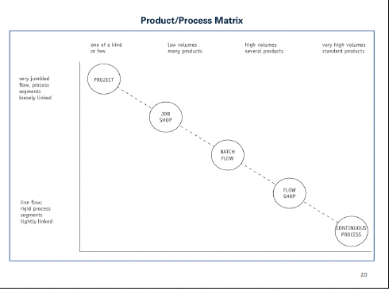
Product/ Process Matrix
FLOW SHOP:
-high volume
-standardized product
-high utilization
Ex: fast food production process
JOB SHOP:
-low volume
-custom orders
-low utilization
Ex: custom shoes / cars

Slide 76
Ts= 1/ u : average time spent at server
Is = utilization
All corrected material will be posted on the CMP website to look back on. Including recordings.

Slide 77
Sarah’s 204 Study Tips
Know the difference between all the different Pk Formulas. Ex: M/M/1, M/D/1, etc.
Practice problems on practice problems!!!
Go over previous assignments + cases
Going forward: review material and practice RIGHT after class
Notes:
Get a good taste of what your professors may try to trick you on

Slide 78
Thank you!
Feel free to stick around to ask some questions

Slide 79

Notes:
Share during 2nd break

